Slide 1

Integrals Applied Electronics Part 2
RCET 0264 Introductory Calculus
Tim Leishman

Slide 2

Integrals Applied Electronics Part 2
Example 1: If we apply a voltage $v=90t^{\frac{1}{2}}$ to a circuit consisting of a 30 henry inductance shunted by a 50 ohm resistance, what current flows when t = 4 seconds? (let $i=0 when t=0$)
$ig=\frac{V}{R}+\frac{1}{L}\int{v dt}$
$ig=\frac{90t^{\frac{1}{2}}}{50}+\frac{1}{30}\int{90t^{\frac{1}{2}}dt}$
$ig=\frac{90t^{\frac{1}{2}}}{50}+\frac{1}{30}\left(\frac{90t^{\frac{1}{2}+\frac{2}{2}}}{\frac{1}{2}+\frac{2}{2}}\right)+C$
$ig=\frac{9t^{\frac{1}{2}}}{5}+{2t}^{\frac{3}{2}}+C$
$ig=\frac{9(4^{\frac{1}{2}})}{5}+{2(4}^{\frac{3}{2}})+C$
$ig=3.6+16+0$
$ig=19.6 amps$

Slide 3

Integrals Applied Electronics Part 2
Example 2: In a parallel RL circuit, $R=5Ω$ and $L=0.2 henrys.$ If a voltage $v=t^{\frac{3}{2}}+2 volts$ were applied, what would the current $i$ be when $t=4 seconds$? Assume $i=0.4amps when t=0.$
$ig=\frac{v}{R}+\frac{1}{L}\int{v dt}$
$ig=\frac{t^{\frac{3}{2}}+2}{5}+\frac{1}{0.2}\int{(t^{\frac{3}{2}}+2) dt}$
$ig=\frac{t^{\frac{3}{2}}+2}{5}+\frac{1}{0.2}\left(\frac{t^{\frac{3}{2}+\frac{2}{2}}}{\frac{5}{2}}+\frac{2t^{0+1}}{1}\right)+C$
$ig=\frac{t^{\frac{3}{2}}+2}{5}+\frac{1}{0.2}\left(\frac{2t^{\frac{5}{2}}}{5}+\frac{2t}{1}\right)+C$
$ig=\frac{t^{\frac{3}{2}}+2}{5}+\left(\frac{2t^{\frac{5}{2}}}{1}+\frac{2t}{0.2}\right)+C$
$ig=\frac{4^{\frac{3}{2}}+2}{5}+\left(\frac{2×4^{\frac{5}{2}}}{1}+\frac{2×4}{0.2}\right)+0.4$
$ig=2+\left(64+40\right)+0.4$
$ig=106.4 amps$

Slide 4
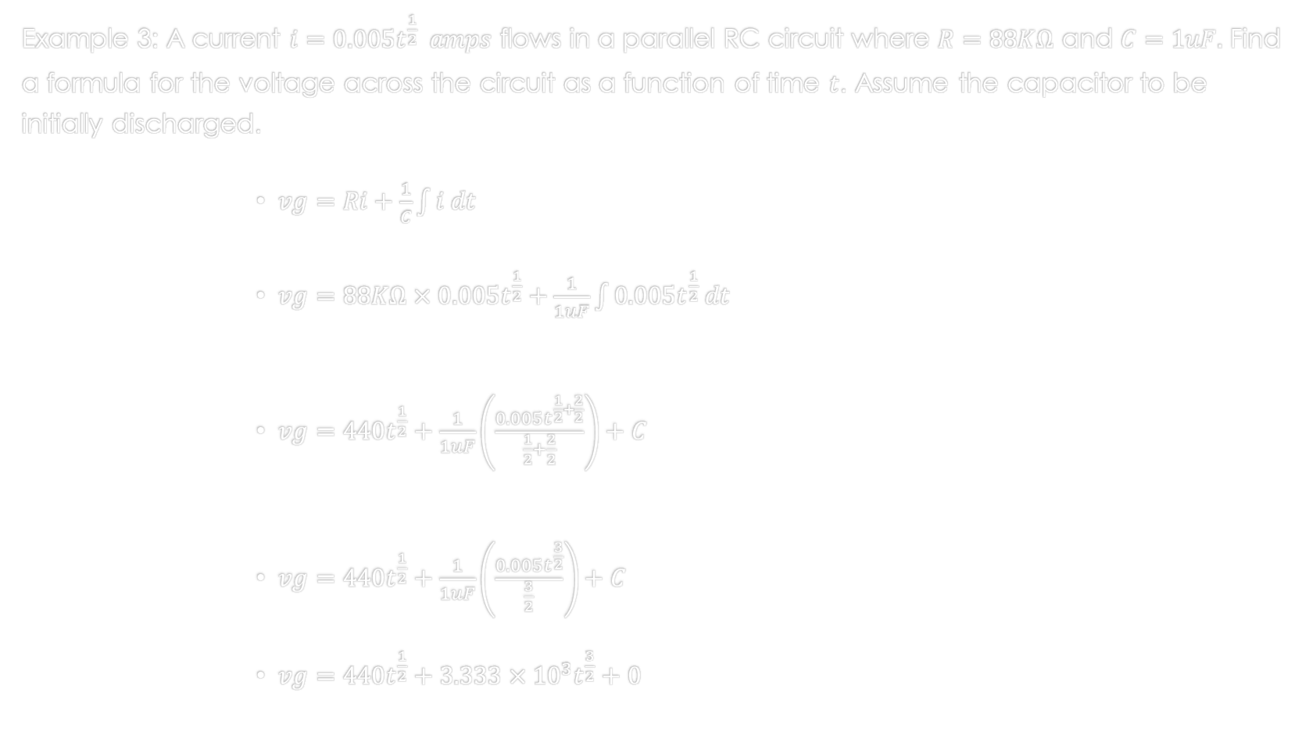
Integrals Applied Electronics Part 2
Example 3: A current $i=0.005t^{\frac{1}{2}} amps$ flows in a parallel RC circuit where $R=88KΩ$ and $C=1uF.$ Find a formula for the voltage across the circuit as a function of time $t$. Assume the capacitor to be initially discharged.
$vg=Ri+\frac{1}{C}\int{i dt}$
$vg=88KΩ×0.005t^{\frac{1}{2}}+\frac{1}{1uF}\int{0.005t^{\frac{1}{2}} dt}$
$vg=440t^{\frac{1}{2}}+\frac{1}{1uF}\left(\frac{0.005t^{\frac{1}{2}+\frac{2}{2}}}{\frac{1}{2}+\frac{2}{2}}\right)+C$
$vg=440t^{\frac{1}{2}}+\frac{1}{1uF}\left(\frac{0.005t^{\frac{3}{2}}}{\frac{3}{2}}\right)+C$
$vg=440t^{\frac{1}{2}}+3.333×{10}^{3}t^{\frac{3}{2}}+0$

Slide 5
References:
Ewen, D., Gary, J. S., & Trefzger, J. E. (2005). Technical calculus. Upper Saddle River, NJ: Pearson/Prentice Hall.
Richmond, A. E., & Hecht, G. W. (1995). Calculus for electronics. New York: Glence.

